Slide 1
Hotel Reservation Management
Kara Walters

Slide 2
This system allows for its guests to view accurate and up-to-date information about the hotel rooms they are staying at. The hotel guests are able to scroll through amenity lists and hotel room photos. Any of the hotel staff members can sign into the system and update the hotel information. They can also help assist guests with their reservations. Hotel management can alter hotel room information as well.

Slide 3
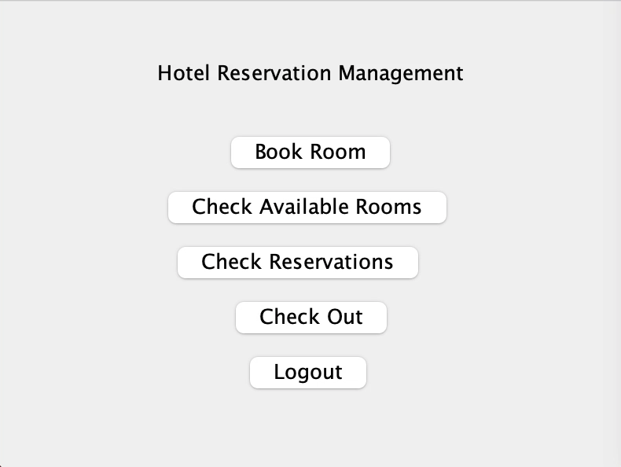
Home Screen

Slide 4
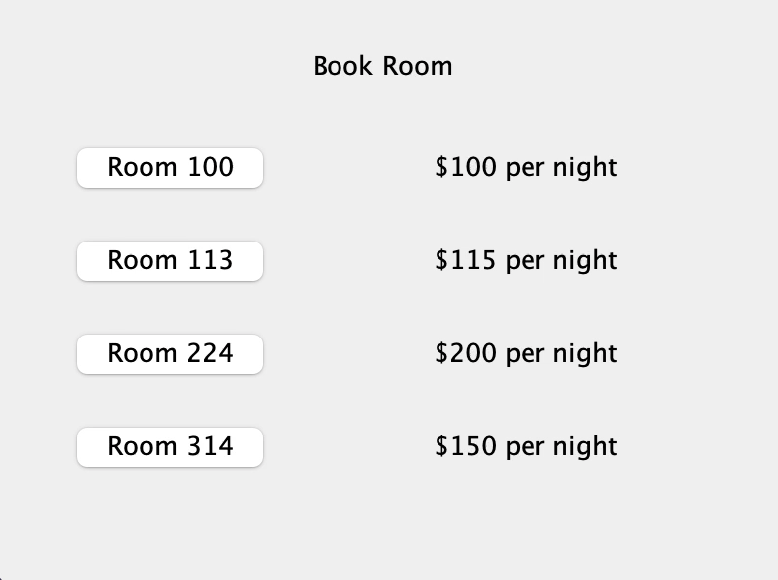
Booking a Room
In the backend, the system holds a list of all available rooms that are open for reservations by guests. Once a guest/user clicks on a room, they are able to view amenity lists.

Slide 5
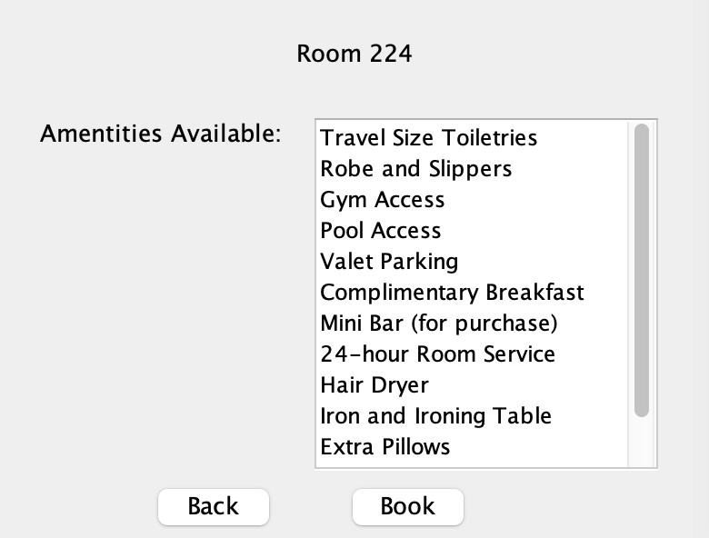
Room Amenity List

Slide 6
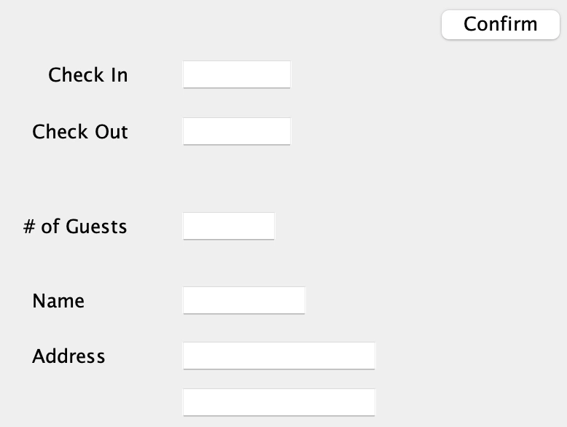
Reservation Page
From this page, a guest/user can make a reservation for the room they have selected. In the backend, reservation dates are then blocked out so other users can not go in and select those dates. The backend also logs the check-in and check-out dates, number of guests, name, and address from the guest/user.

